Slide 1


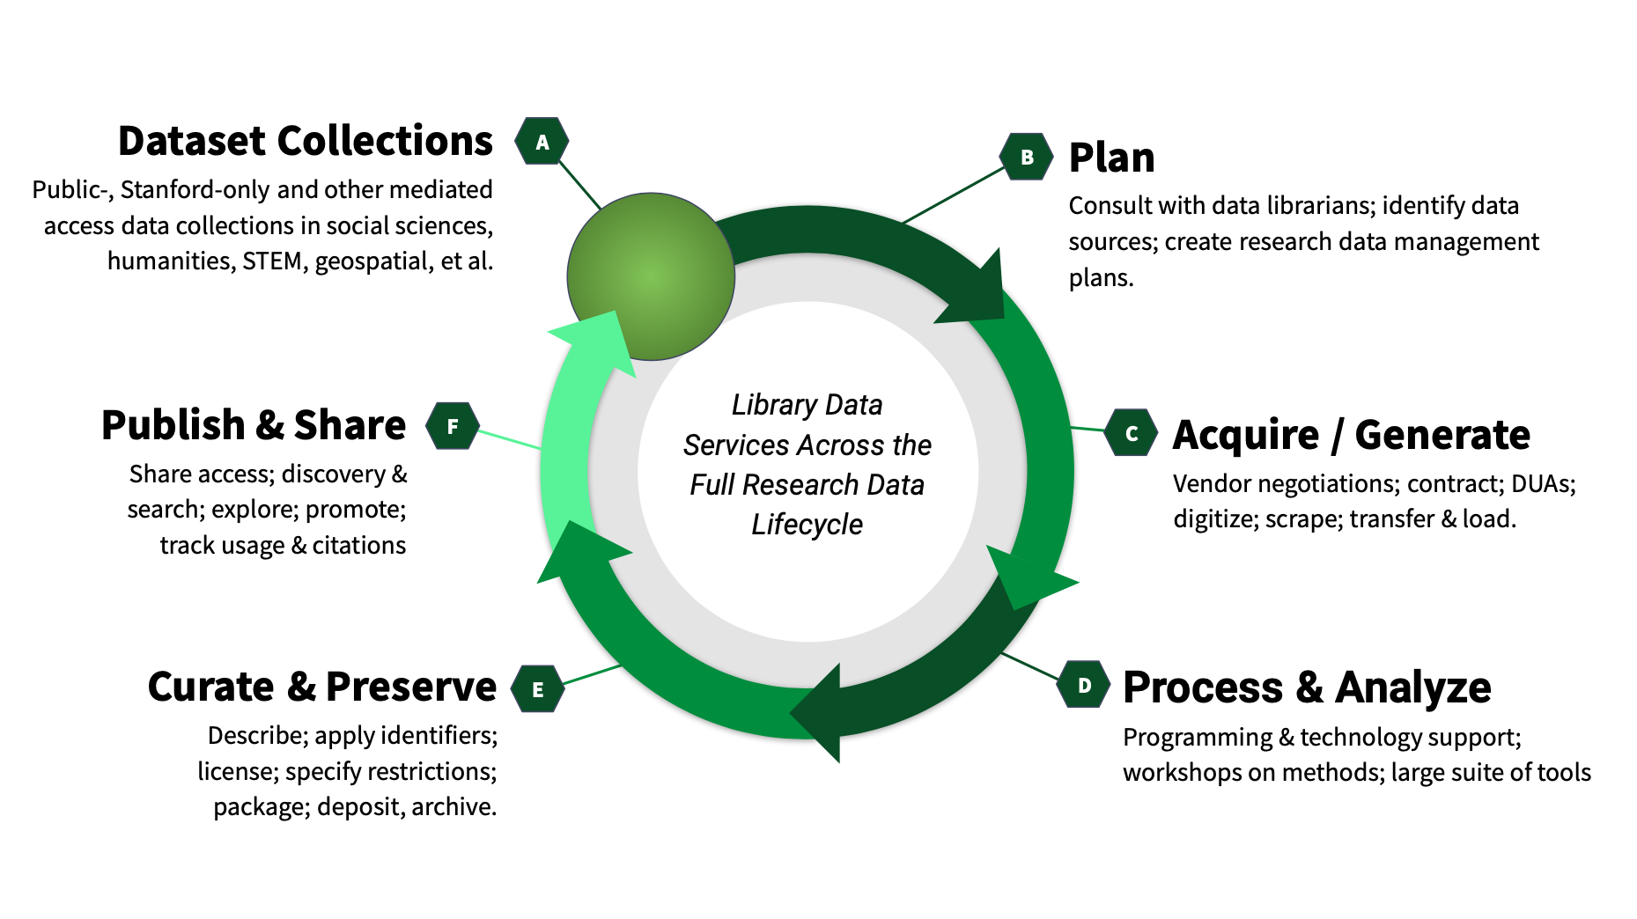
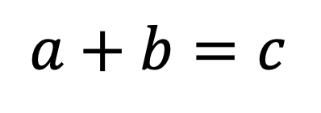
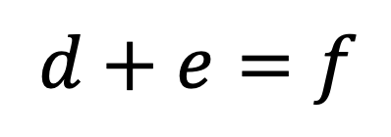
The Title of the Poster (66 point font, bold)
Author Surname Initials¹, Co-author Surname Initials², and Co-author Surname Initials³ (36 point font, bold)
¹Affiliation, Country (32 point font, bold, one line only)
²Affiliation, Country (32 point font, bold, one line only)
Corresponding Author’s E-mail Address (32 point font, bold, one line only)
Abstract (44 point font, bold)
Abstract of the study should be included in here (36 point font, single-spaced). All abstracts submitted to the ComURS2024 are required to be displayed as posters. Please use this document as a template to form the poster in which you can type your own text and paste figures and tables.
Keywords (36 point font, bold letters) : Information Systems, Software Engineering, Data Science (36 point font, bold letters, one line if possible)
Introduction (44 point font, bold)
Introduction of the study should be included in here (36 point font, single-spaced). Try to keep it simple, but professional and entertaining.
Use small blocks of 50-60 words maximum
Use short sentences
Use bullet points, flow charts and block diagrams
Have clearly defined sections – work with the background coloured boxes to organise the flow of your poster
Literature Review (44 point font, bold)
Literature review of the study should be included in here (36 point font, single-spaced). This is the template for preparation of posters for ComURS2024. Please use this document as a sample of the symposium poster.
Results and Discussion (44 point font, bold)
Results of the study should be included in here (36 point font, single-spaced). This is the template for preparation of posters for ComURS2024. Please use this document as a sample of the symposium poster.
Fig. 1. Title of the figure (32 point font, align to left)
Methodology (44 point font, bold)
Methodology of the study should be included in here. This is the template for preparation of posters for ComURS2024. Please use this document as a sample of the symposium poster.
Template of Font (40 point font)
All the items in your poster should be presented as an uniform layout. Do NOT change the font sizes and font colours in the template.
Move the mouse to the beginning of the last column of each paragraph, press the key of “Enter” to interrupt the last column, and then make it LEFT align. Other columns in each paragraph are recommended to be JUSTIFY align.
Template of Figures and Tables (40 point font)
More Figures and Tables are preferred for your poster to present your outstanding works in ComURS2024. Try to make your Figures are transparent to suit the background of the poster. Nevertheless, keep them simple and uncluttered with legends and axes legible from ~1 meter away. Additionally using frames will highlight your figures. In addition, all the items in the Figures and Tables such as lines, words, symbols are recommended to be identical to the colour of the TEXT in the template. Place the Table captions above the tables and link it with the text (see Table 1). Place Figure captions below the figures.
(1)
(2)
Table 1. Heading of the table (32 point font, centre)
Conclusion (44 point font, bold)
Conclusion of the study should be included in here (36 point font, single-spaced). A few more tips on the poster formatting:
Use bold or italic or colour to highlight keywords, but avoid underlining text as it makes it hard to read
Do not use all capital letters, again IT MAKES IT HARDER TO READ.
You can change the size/location of the coloured background boxes to adapt it to your needs
Try to use a font that is easy to read (this one is Calibri and nice and clear on a poster). Please use it in line with this template.
The font sizes given in this example should be the minimum you are using. Everything smaller than that will be hard to read. More importantly, you will be tempted to write more than needed.
References (40 point font, bold)
References of the study should be included in here (32 point font, single-spaced). IEEE referencing style should be used.
[1] X.Y. Cole, Enter main references here, ASEMD’2018, Apr. 15-18, 2018.
[2] X.Y. Cole, How to prepare the poster in ASEM, ASEM, vol. 3, no. 1, pp. 1-4, 2018.
 | A | B | C | D | E | F | G | H | I
Test 1 | 1 | 0 | 0 | 0 | 1 | 1 | 0 | 0.05 | 0.15
Test 2 | 0.1 | 0 | 2 | -2 | 0.7 | 1 | 0 | 0.06 | 0.12
Computing Undergraduate Research Symposium (ComURS2024)
Faculty of Computing
Sabaragamuwa University of Sri Lanka
Acknowledgements
This study has been conducted within the framework of XX OR is funded by XXXXXXXXX.

